Slide 1



Postman
Integrative Programming

Slide 2



Outline
What is Postman?
Getting started
www.its.ac.id
INSTITUT TEKNOLOGI SEPULUH NOPEMBER, Surabaya - Indonesia

Slide 3

Postman
Postman an application to interact with web based API
Postman helping to connect to the API for sending request and receiving data in an easy way
www.its.ac.id
INSTITUT TEKNOLOGI SEPULUH NOPEMBER, Surabaya - Indonesia

Slide 4
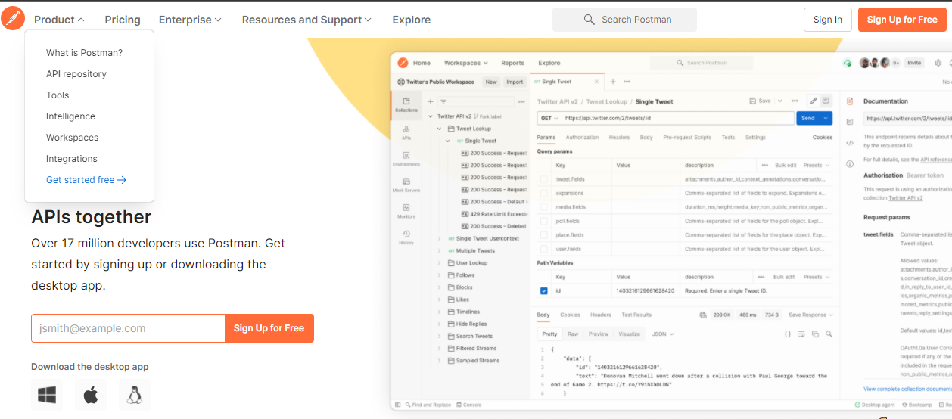
Getting started
Postman installation
Go to postman.com
You can directly sign up or download the desktop version
www.its.ac.id
INSTITUT TEKNOLOGI SEPULUH NOPEMBER, Surabaya - Indonesia

Slide 5
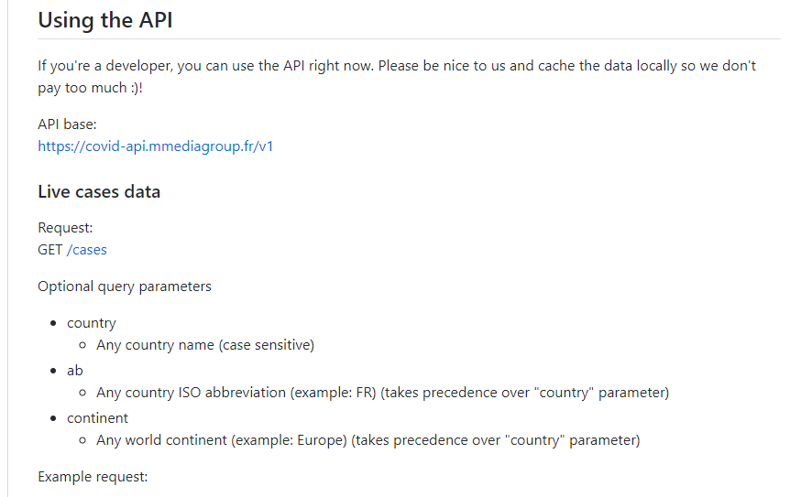
First Request
Before we start to send request to the API, we have to look at the API documentation
The documentation shows how to use the API
www.its.ac.id
INSTITUT TEKNOLOGI SEPULUH NOPEMBER, Surabaya - Indonesia

Slide 6
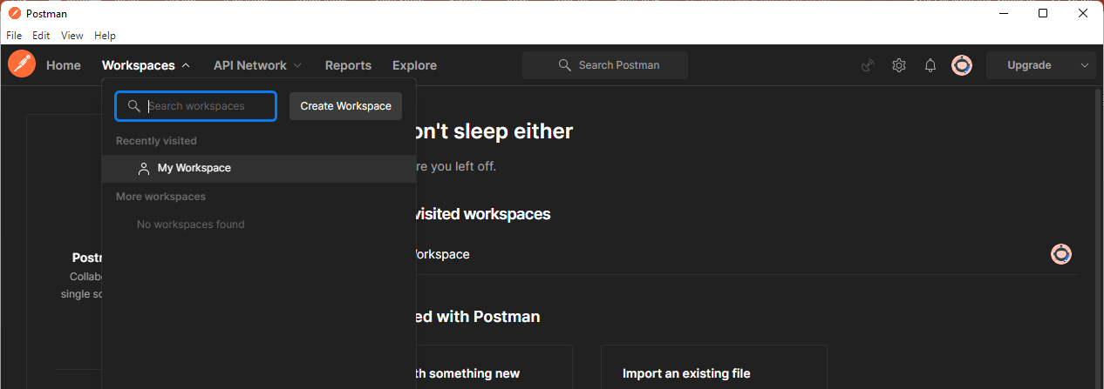
First Request
Select Workspaces → My Workspace
www.its.ac.id
INSTITUT TEKNOLOGI SEPULUH NOPEMBER, Surabaya - Indonesia

Slide 7
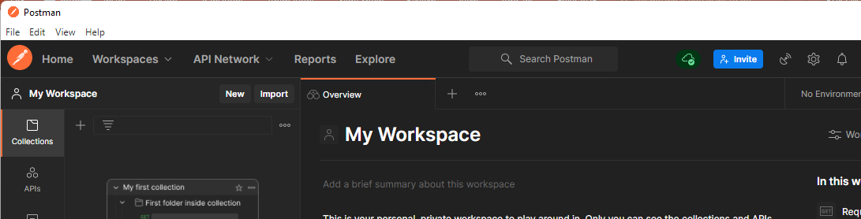
First Request
Choose new tab
www.its.ac.id
INSTITUT TEKNOLOGI SEPULUH NOPEMBER, Surabaya - Indonesia

Slide 8
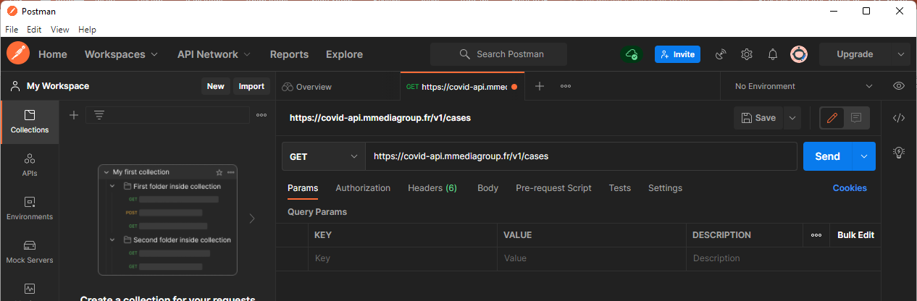
First Request
Copy the URL+endpoint
www.its.ac.id
INSTITUT TEKNOLOGI SEPULUH NOPEMBER, Surabaya - Indonesia

Slide 9
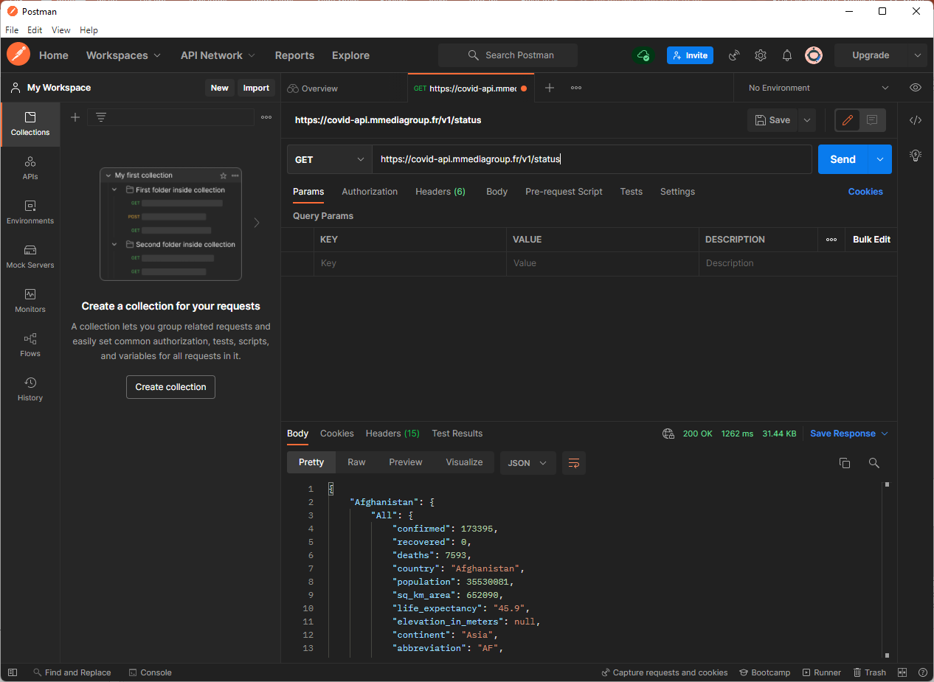
Response
www.its.ac.id
INSTITUT TEKNOLOGI SEPULUH NOPEMBER, Surabaya - Indonesia

Slide 10

Response
Request
Client
HTTP
Server
Response
www.its.ac.id
INSTITUT TEKNOLOGI SEPULUH NOPEMBER, Surabaya - Indonesia
Notes:
HTTP messages used to communicate between client and server

Slide 11
Request
www.its.ac.id
INSTITUT TEKNOLOGI SEPULUH NOPEMBER, Surabaya - Indonesia

Slide 12
Request
The address or URL
The endpoint
www.its.ac.id
INSTITUT TEKNOLOGI SEPULUH NOPEMBER, Surabaya - Indonesia

Slide 13
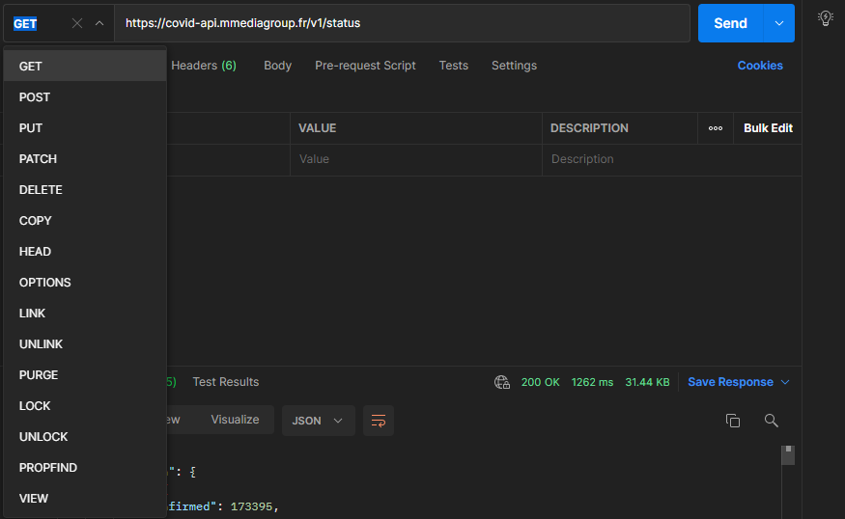
Request
Request methods
www.its.ac.id
INSTITUT TEKNOLOGI SEPULUH NOPEMBER, Surabaya - Indonesia

Slide 14
Request
Properties
www.its.ac.id
INSTITUT TEKNOLOGI SEPULUH NOPEMBER, Surabaya - Indonesia

Slide 15
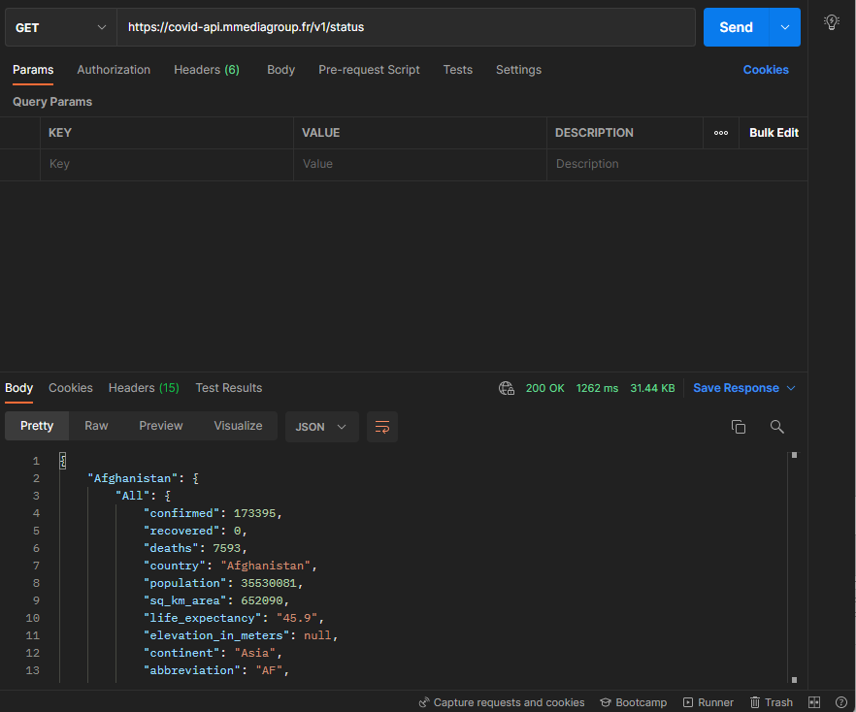
Response
Response
www.its.ac.id
INSTITUT TEKNOLOGI SEPULUH NOPEMBER, Surabaya - Indonesia

Slide 16
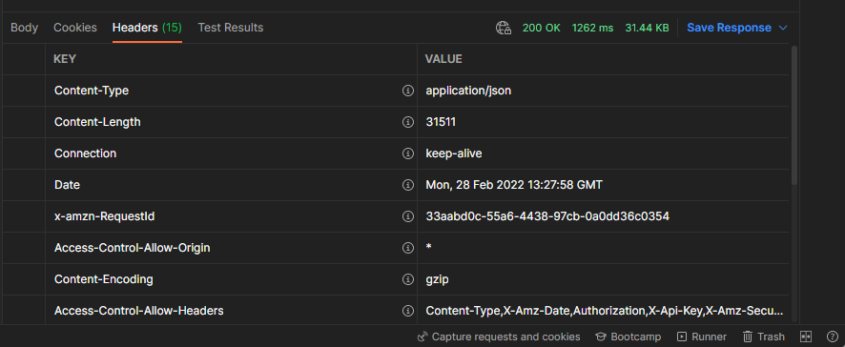
Response
Header consist of meta information of the messages
www.its.ac.id
INSTITUT TEKNOLOGI SEPULUH NOPEMBER, Surabaya - Indonesia

Slide 17
Response
Body consist of messages that we want to get
www.its.ac.id
INSTITUT TEKNOLOGI SEPULUH NOPEMBER, Surabaya - Indonesia

Slide 18
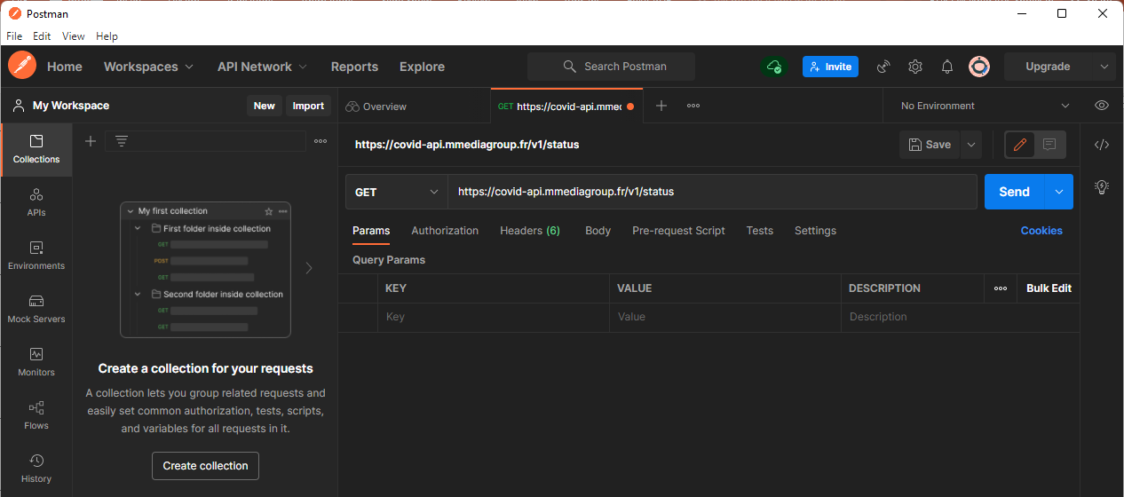
Save the request
www.its.ac.id
INSTITUT TEKNOLOGI SEPULUH NOPEMBER, Surabaya - Indonesia

Slide 19
Variable
In Postman, variables enable to store and reuse values in request or script
Increase work efficiency and minimize error
It useful if the values is used in multiple places
www.its.ac.id
INSTITUT TEKNOLOGI SEPULUH NOPEMBER, Surabaya - Indonesia

Slide 20
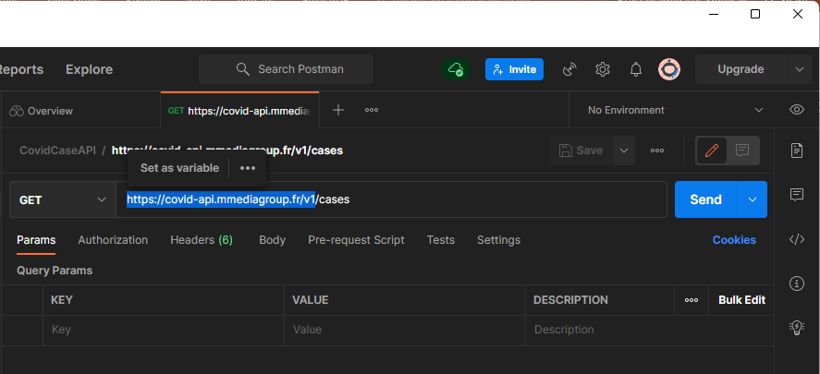
Set URL as variable
www.its.ac.id
INSTITUT TEKNOLOGI SEPULUH NOPEMBER, Surabaya - Indonesia

Slide 21
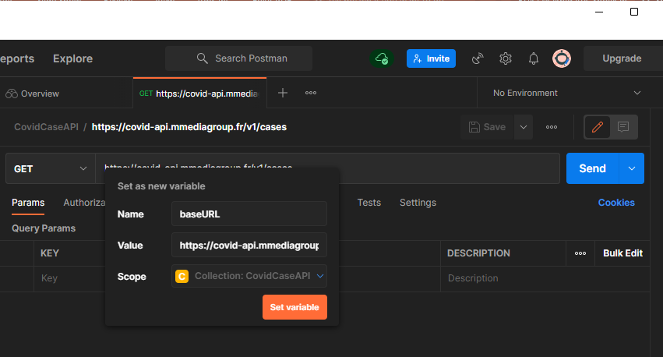
Set URL as variable
www.its.ac.id
INSTITUT TEKNOLOGI SEPULUH NOPEMBER, Surabaya - Indonesia

Slide 22
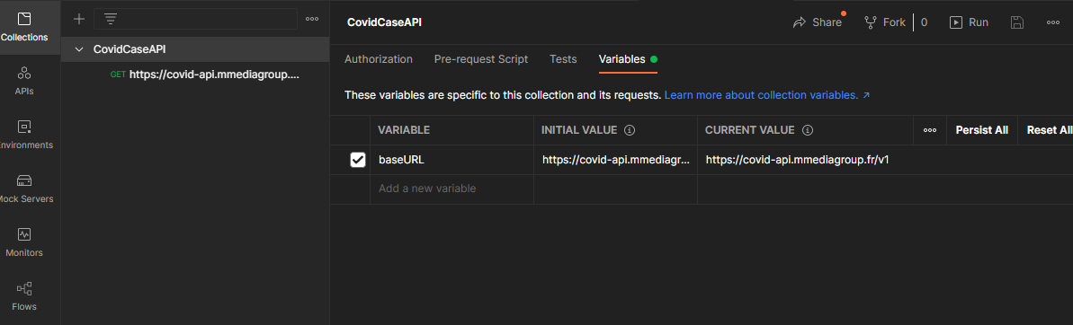
Edit variable
Choose the collection → Edit → Variables
www.its.ac.id
INSTITUT TEKNOLOGI SEPULUH NOPEMBER, Surabaya - Indonesia

Slide 23
Variable scopes
Global
Collection
Environment
Data
Local
Global > Collection > Environment > Data > Local
Note: if a variable with the same name declare in two scopes. The narrowest scope will be used
www.its.ac.id
INSTITUT TEKNOLOGI SEPULUH NOPEMBER, Surabaya - Indonesia

Slide 24
Variable scopes
Global variables
Enable to access data between collections, requests, test scripts, and environments
Collection variables
Available only inside a collection
Environment variables
Enable to process to different environment
Local variables
Temporary, only access in the request script
When the run is complete the variable is discarded
Data variables
Came from external CSV or JSON to define data sets
www.its.ac.id
INSTITUT TEKNOLOGI SEPULUH NOPEMBER, Surabaya - Indonesia

Slide 25
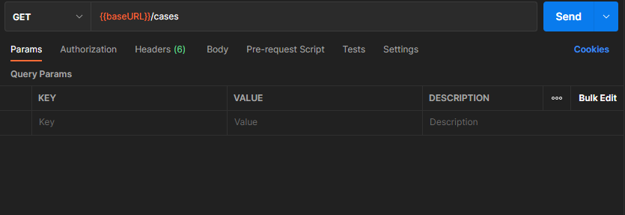
Query parameters
Some additional data that we can submit when sending a request
It can be optional or mandatory, depending on the API
www.its.ac.id
INSTITUT TEKNOLOGI SEPULUH NOPEMBER, Surabaya - Indonesia

Slide 26
Exercise
Create a collection for Simple Book API
https://github.com/vdespa/introduction-to-postman-course/blob/main/simple-books-api.md
Send request based on the documentation (/status and /books)
For each request script save it inside the collection
Do not forget to change the URL into variable
www.its.ac.id
INSTITUT TEKNOLOGI SEPULUH NOPEMBER, Surabaya - Indonesia

Slide 27
Path Variables
Path variables allow for defining variables within a URL that are part of the URL path
Retrieve detail information
www.its.ac.id
INSTITUT TEKNOLOGI SEPULUH NOPEMBER, Surabaya - Indonesia

Slide 28
Path Variables
Path variables allow for defining variables within a URL that are part of the URL path
Retrieve detail information
www.its.ac.id
INSTITUT TEKNOLOGI SEPULUH NOPEMBER, Surabaya - Indonesia

Slide 29
TERIMA KASIH

